Slide 1
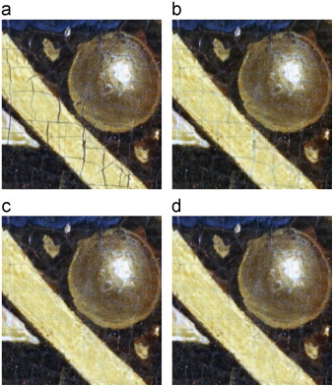
Fig. 1 Crack types: dark cracks on bright background (top), and bright cracks on dark background (bottom). The width of the mouth is 2.86 cm (approximately 1.13 in) on the panel.
B. Cornelis , T. Ružić , E. Gezels , A. Dooms , A. Pižurica , L. Platiša , J. Cornelis , M. Martens , M. De Mey...
Crack detection and inpainting for virtual restoration of paintings: The case of the Ghent Altarpiece
Signal Processing, Volume 93, Issue 3, 2013, 605 - 619
http://dx.doi.org/10.1016/j.sigpro.2012.07.022

